Slide 1
City of Burnsville, Minnesota
Financial Management Plan Update
March 25, 2025

Slide 2
Goals for the Work Session
To continue the discussion from the 2025 Budget process about strategic direction and organizational needs
To review the Financial Management Plan (FMP) Update and receive guidance from the City Council on:
Property Tax Levy Changes
Debt Issuance Assumptions
To begin the development of the Proposed 2026 Budget
Notes:
It will be an iterative process, with considerable analysis and opportunity for discussion

Slide 3
What is a Financial Management Plan?
A multi-year fiscal plan for all tax-supported funds
Integrates:
Existing debt
Capital Improvement Plans
Future debt
Tax base growth
Future operating costs
Assures all capital, maintenance, staffing needs are met and there are sustainable funding sources
Notes:
Designed to incorporate all previous actions and directions of the City Council

Slide 4
FMP Update Funds
General
EDA
Cable Franchise Fee
Forestry
Facilities Capital
Parks Renovation
Parks Investment (New!)
Equipment and Vehicle
Information Technology
Infrastructure Trust
Street Revolving
Improvement Construction
Ames Center
Golf Course
Ice Center
Notes:
-Reviewed 15 total funds and will discuss 11 today. The other four are functioning as expected and do not require any modifications at this time, which could change.
-The “starred” funds are the ones to be reviewed today.

Slide 5
Economic Expectations
The long-term, economic projection for the State of Minnesota (State) revised to reduce long-term growth
Inflation remains at of above 2.0% over the next five years
Projected State budget surplus of about $456 million for the next biennium
Several factors continue to create economic uncertainty
Geopolitical conflicts
Disruptions related to Federal agency closures
Shifts in Federal fiscal and monetary policies
Negotiations on the State budget and tax polices
Notes:
-About 35% of the State budget over the next biennium funded through Federal sources
-Including inflation, the State projects a future budget shortfall of about $6 billion
-The State currently projects about $700 million in debt capacity
-Mention possible elimination of the tax-exemption as part of the Federal tax/budget discussions
-Concern about the impact of loss of Federal funds and potential impact on the State budget/pass throughs

Slide 6
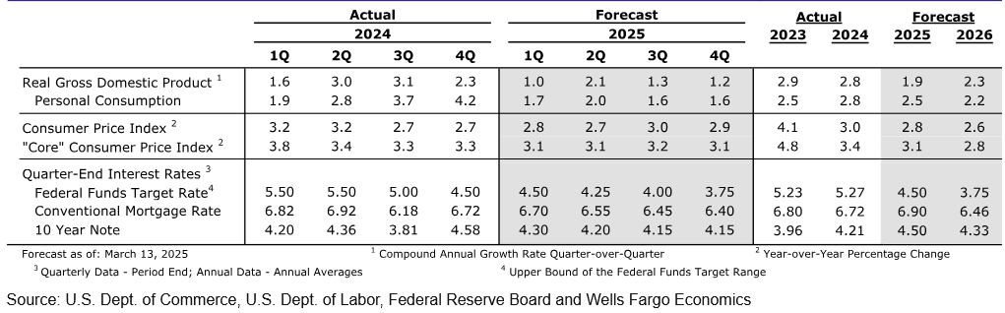
Economic Expectations, Continued
Source: Wells Fargo, Weekly Economic & Financial Commentary

Slide 7
Assumptions & Other Factors
Recommended fund balance requirements for all funds
General Fund: 40% to 50% of expenditures and at 45% throughout the planning window
Capital Project Funds: 35% of rolling 5-year expenditure average
Enterprise Funds: 6 months of operating expenses
All capital projects are funded per the respective Capital Improvement Plans and most recent project estimates
Excludes any planned carry forward amounts

Slide 8
Assumptions and Other Factors, continued…
Added Full-Time Equivalents (FTEs) per the recent Organizational Analysis to the General Fund
Also included the Lead the Market Compensation Strategy
New development growth built in through 2026 and 2% thereafter
2.5% increase in revenues, 3.5% increase in expenditures
$198.3M in projected debt over next 10 years
Primarily driven by anticipated facilities projects
Designed to support the rating evaluation service process
Notes:
- About $110 million of that debt will be to support planned facility improvements from 2026 - 2035
- Doesn’t include the $100M planned for in 2025

Slide 9
Pending Data & Studies
Fleet Study
Information Technology Plan
Municipal Facilities Inventory
Sidewalks & Trails Plan
Traffic Signal & Street Lighting Study
Street Lighting Plan
City-Owned Property Plan
Infrastructure Trust Fund Plan
Notes:
-Will be incorporated into the FMP and the Proposed 2025 Budget
-Horizontal Infrastructure Plan (excluded from the slide since the FMP does not include the utility funds)
-Ongoing and annually updated Organizational Analysis

Slide 10
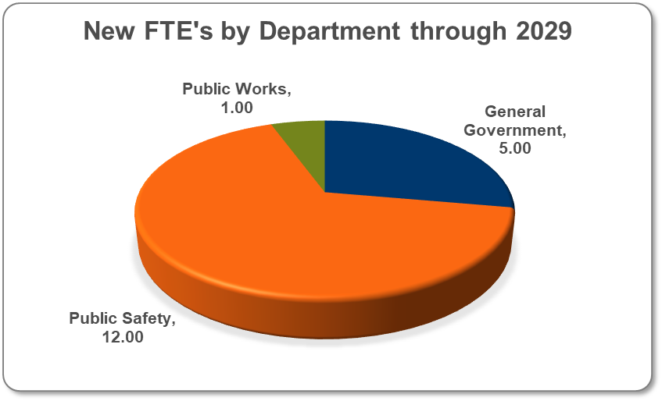
General Fund – New Positions
18.0 new staff positions over next 4 years
10 in 2026 = $1.5M
3 in 2027 = $182k
2 in 2028 = $353k
3 in 2029 = $436k
Notes:
-Approximately 75% of General Fund expenditures are for personnel services
-Includes all FTEs from the “Rebalanced Organizational Analysis” as well as the police staffing study
-12, or 2/3, of the new FTEs currently allocated to public safety, directly
-Includes 6 Fire positions to start in 2025 using budget savings. Fully realized in 2026 for $1,031,100.
-Moved the Financial Analyst and IT Engineer from 2026 to 2027 ($201k)

Slide 11
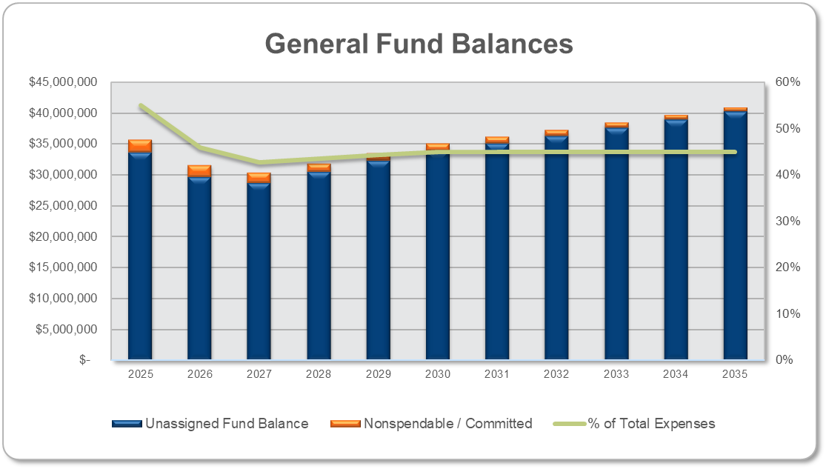
General Fund
Key Takeaways
Preliminary 2024 better than projected
Revenues higher by nearly $900k
Expenses down by nearly ($1.5M)
Future projections show stable balances (at 45%)
Notes:
-Reflects a planned draw down in fund balance as begun by City Council as part of the 2023 budget
-Depends to 43% of the subsequent year's expenditures in 2027 and remains at about 44% in 2028 before returning to 45% by 2030

Slide 12
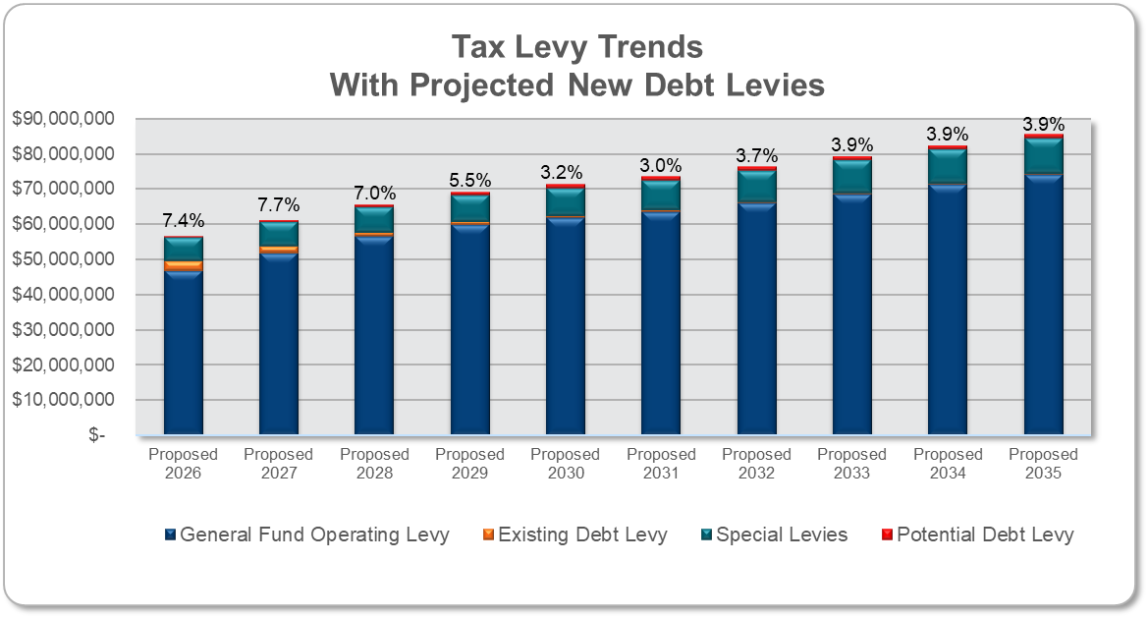
Property Tax Levy Trends
Key Takeaways
Includes non-binding, annual levy changes
Facilities debt paid with Franchise Fees
Inflationary levy increases expected after 2027
Notes:
-Designed to ensure the City remains above 40% fund balance and return/maintain its fund balance policy position of 45%
-The property tax levy adjustments in 2028, 2029 and 2030 allow the City to return to a 45% fund balance requirement, and the subsequent amount keep it there
-Could be “smooth out” over a greater number of years, but it would result in lower fund balances annually – “flying closer to the sun” so to speak
-Does not reflect any of the potential costs related to the pending studies mentioned on the previous slide

Slide 13
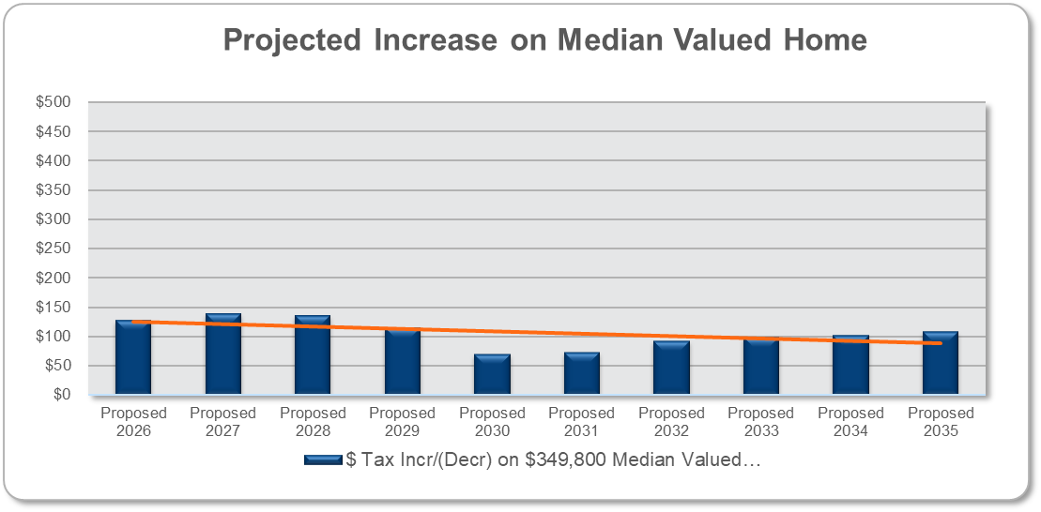
Impact on Median-Valued Home
Next 10 Years
State law changes impact Residential Homesteads
2026: $129/year ($11/$.36) = 8.4%
2027: $139/year ($12/$.39) = 7.3%
2028: $146/year ($12/$.40) = 8.4%
Other Years: $94/year average
Assumes 2% annual increase in existing property values
Notes:
-Assumes a median-valued home of $349,800
-Includes an assumption for a 2% increase in valuation annually
-Total Pay 2025 tax base down 1.6% from last year due to change in Homestead Market Value Exclusion and flat market values overall
-Homestead Market Value Exclusion: Phase-out increased from $413,800 to $517,200
-Additional $20,826 in excluded value on median valued home = $42/year tax savings

Slide 14
Preliminary Payable 2026 Market Values
Taxable Market Values By Classification
Classification | 2025 | 2026 | Change ($) | Change (%)
Residential | 5,852,855,546 | 6,027,812,537 | 174,956,991 | 2.99%
Commercial | 969,618,900 | 1,001,965,200 | 32,346,300 | 3.34%
Industrial | 911,248,900 | 982,752,800 | 71,503,900 | 7.85%
Utility | 181,932,900 | 182,443,400 | 510,500 | 0.29%
Apartments | 1,505,988,900 | 1,474,111,600 | 31,877,300 | 2.13%
Railroads | 8,734,600 | 8,734,600 | - | 0.00%
Personal Property | 28,503,000 | 28,201,100 | (301,900) | (1.06)%
Total | 9,458,882,746 | 9,706,021,237 | 310,893,091 | 3.29%
Estimated Market Value
Classification | 2025 | 2026 | Change ($) | Change (%)
All | 9,748,560,600 | 9,983,274,500 | 234,713,900 | 2.40%
Source: Dakota County Assessor, Preliminary Payable 2026 Market Values

Slide 15
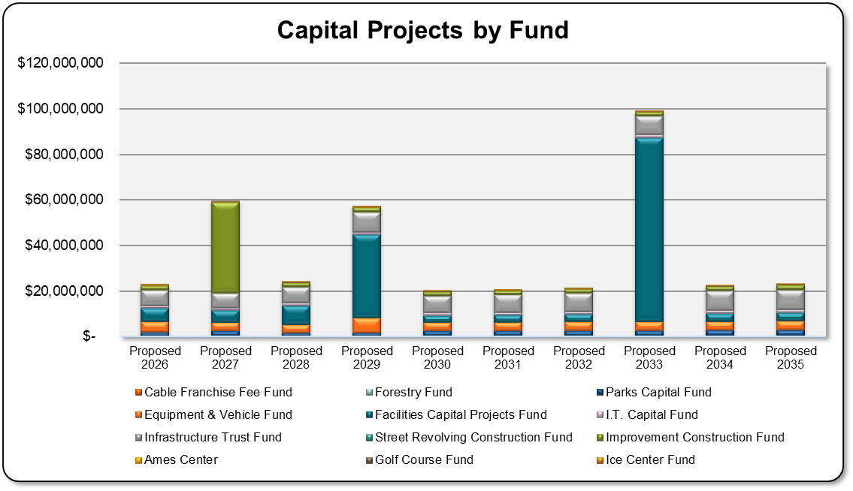
Overall Capital Project Needs
$368.6M in capital projects over next ten years (2026–2035)
Excludes $100M for Police City Hall in 2025
Excludes utility funds not included in the FMP
By Fund
Streets/ITF: $83.8M
Facilities: $154.1M
Vehicles & Equip: $43.9M
Parks: $25.9M
I.T. Capital: $11.4M
All Others: $3.8M
Notes:
-2027 includes about $34 million for the Nicollet/HWY 13 improvements (RAISE grant)

Slide 16
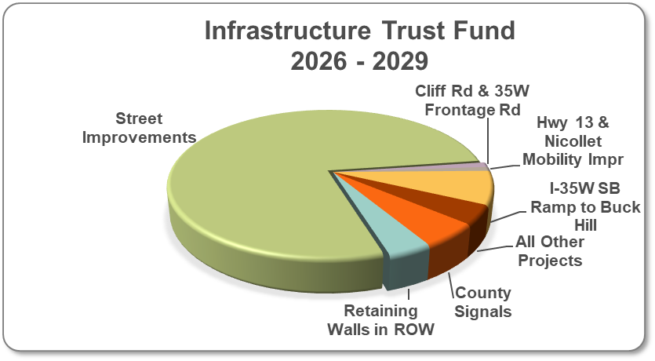
Infrastructure Trust Fund
2026–2029 Projects | Amount*
Street Improvements | $22,881,000
County Signals | 1,542,000
Cliff Rd & 35W Frontage Rd | 309,000
Retaining Walls in ROW | 1,126,000
Nicollet/Hwy 13 (MSAS) | 262,000
I-35W SB Ramp/Buck Hill Rd | 2,132,000
Other Projects | 1,224,000
Total | $29,476,000
2030–2035: Placeholder of $6.0M per year, inflated 3% per year
*Project costs inflated 3% per year

Slide 17
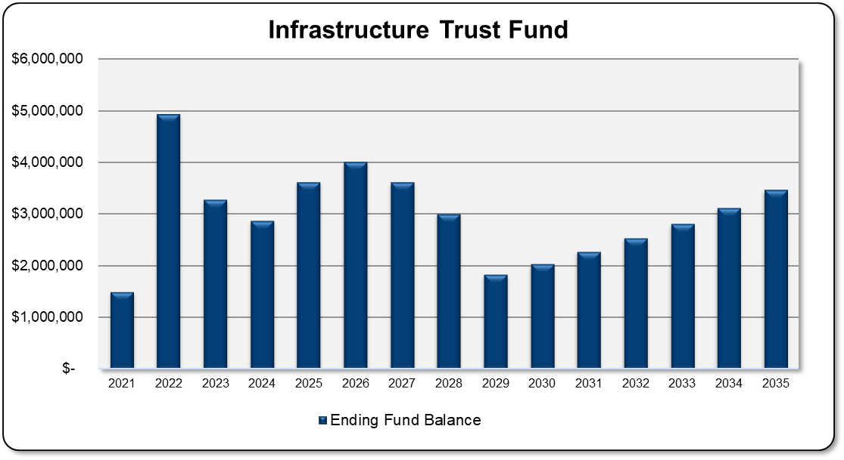
Infrastructure Trust Fund
Next 10 Years
Property tax levy reduced in 2023, added back through 2026
MSA funds vary, average $3.3M annually
No bonding currently included
Notes:
-The fund remains generally above the fund balance requirement
-$1M reduction in the property tax levy; phased return thru 2027 to reduce overall property tax levy pressures
-In 2029, the fund will be about $150k below the fund balance requirement

Slide 18
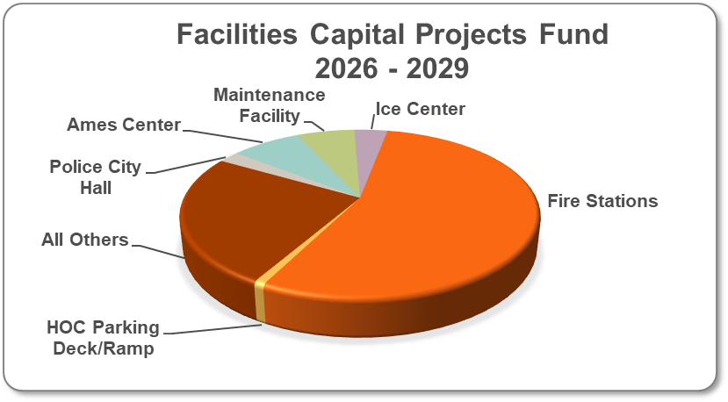
Facilities Capital Project Fund
2026–2029 Projects | Amount*
Police/City Hall** | 1,266,000
Ames Center | 4,264,000
Maintenance Facility | 3,550,000
Ice Center | 2,032,000
Fire Stations | 30,863,000
HOC Parking Deck/Ramp | 466,000
All Others | 14,119,000
Total | $56,560,000
2030–2035: Placeholder of $2.5M per year, inflated 4% per year
* Project costs inflated 3% per year.
** Does not include the $100M for Police City Hall project in 2025
Notes:
-About $8.3 million used to support project related to the enterprise activities
-Assumes three years in between each major project beginning in 2025, Fire Station No. 2 in 2029 and the Maintenance Facility in 2033
-Does not include $1.6M in Carry Forward projects in 2025

Slide 19
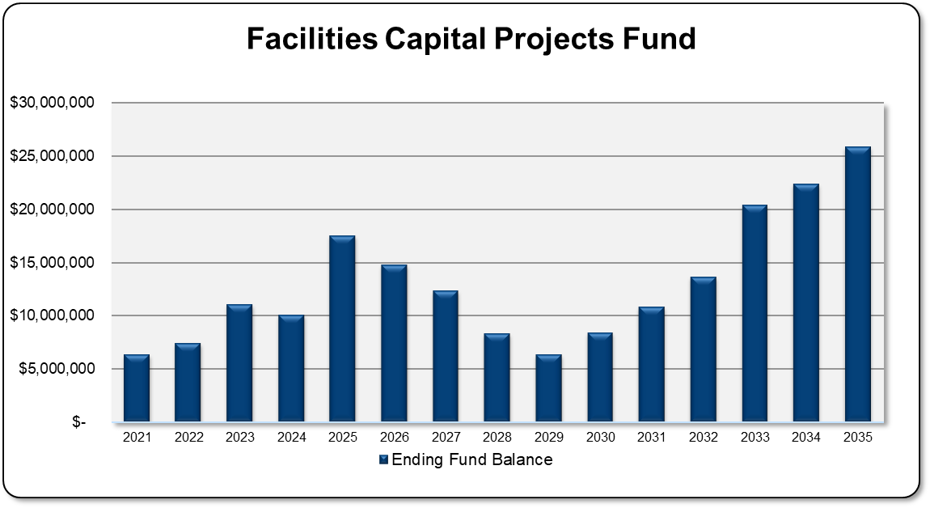
Facilities Capital Project Fund
Next 10 Years
Anticipated Bonding:
2025: $100M, Police City Hall
2029: $30M, Fire Station No. 2
2033: $80M, Main. Facility
Annual debt service projected under Option A: 100% Franchise Fees
Higher funds balances needed to support anticipated debt service
Potential use of fund balance for future projects
Notes:
-Based on information provided to the City Council in February, which are the “latest and greatest” numbers; does not reflect any formal decision by the City Council, but allows the City to model the preferred debt strategy for the credit rating agency
-Includes $4.3M of costs already incurred in 2024; Police City Hall at $96M in 2025
-Includes additional revenue from the Host Fee Agreement starting in 2028– an average of about $538,000 annually over the projection period
-About $17.5 million in debt service by the end of the planning period in 2035
-Fund balance requirement of 35% of a five-year average plus one-year of debt service; about $8 million over the fund requirement in 2035; could be used to reduce borrowing costs or lower franchise fee changes in future years

Slide 20
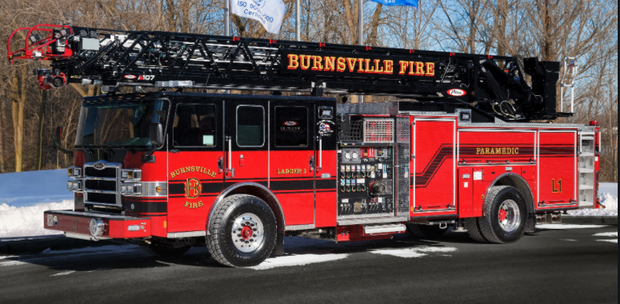
Equipment & Vehicle Fund
2026–2029 Capital Costs
Fire: $7.9M
Police: $2.9M
Streets: $4.3M
Parks: $2.2M
Other: $765k
2030–2035
Placeholder of $4.0M/year
All other costs inflated 1%/year
Notes:
-Vehicles already inflated in City CIP, equipment is not
-About 60% of the equipment cost spent on public safety needs, including about $1.4 million for Rescue Pumper (2026) and $1.75M for Fire Engine (2029)
-Increased the placeholder from 3.5 million to $4.0 million, adjusted for inflation beginning in 2030 through the end of the model

Slide 21
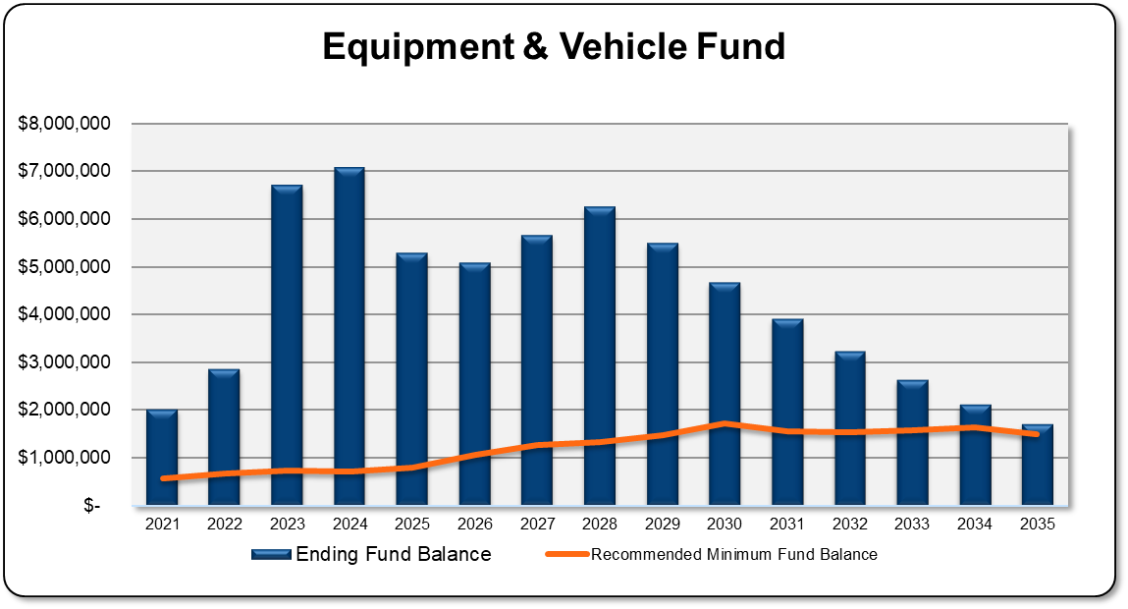
Equipment & Vehicle Fund
Next 10 Years
Property Tax Levy
2026 to 2027: 3% increase annually
2028 to 2035: 6% increase annually
Potential Bonding:
$1.4M: 2026 for Rescue Pumper and Ambulance
$1.149M: 2027 for Loader & Class 7 Truck
$1.0M: 2028 for Ambulance & Dump Truck
$2.29M: 2029 for Ambulance and Fire Engine
Recommended Minimum Fund Balance is 35% of rolling 5-Year Average of Capital Projects
Notes:
-Drop in fund balance in 2025 is a result of no bonding that year
-Increase in 2023 reflects about $2.83 million in one-time public safety aid
-Includes additional revenue from the Host Fee Agreement – an average of about $1.2M annually over the projection period
-Doesn’t include $3.5M in Carry Forward costs in 2025
-Additional equipment certificates may be needed in 2030 and beyond

Slide 22
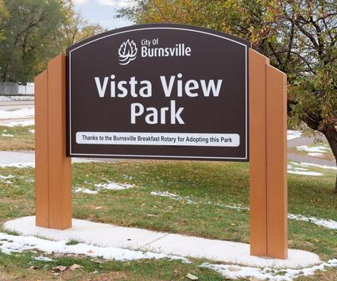
Parks Renovation Fund
Park Dedication moved to new Parks Investment Fund in 2024
2026–2029 Capital Costs
Park Renovations: $7.7M
2030–2035
Placeholder of $2.1M/year
All other costs inflated 3%/year
Notes:
-About $4.44 million of the current capital outlay planned to replace and improve bituminous or concrete surfaces
-$670,000 planned for Oak Leaf West Park in 2025

Slide 23
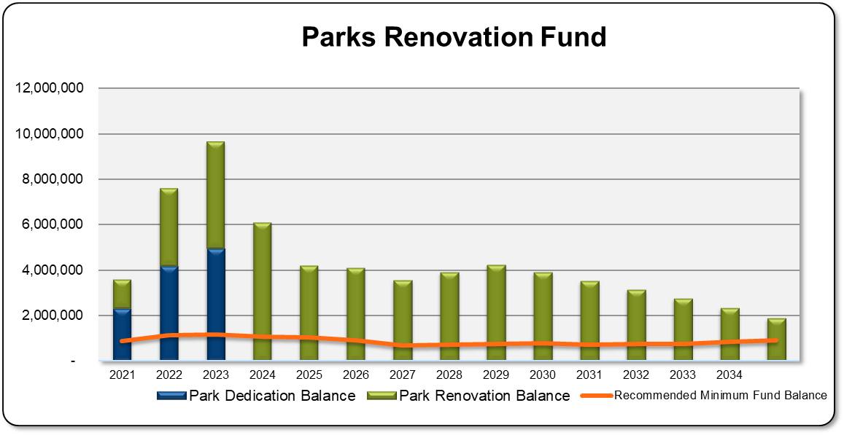
Parks Renovation Fund
Next 10 Years
Property Tax Levy
3.0% annual increase
May be used for any capital projects
Potential Bonding
No bonding currently included
Recommended Minimum Fund Balance is 35% of rolling 5-Year Average of Capital Projects
Notes:
-Includes additional revenue from the Host Fee Agreement – an average of about $780,000 annually over the projection period
-Doesn’t include $533k in Carry Forward costs in 2025
-Major 2025 projects:
Prioritize replacement of condition 1 and 2 items (lowest condition from parks plan)
Remove non-relevant amenities at end of life
Complete future studies to inform future projects

Slide 24
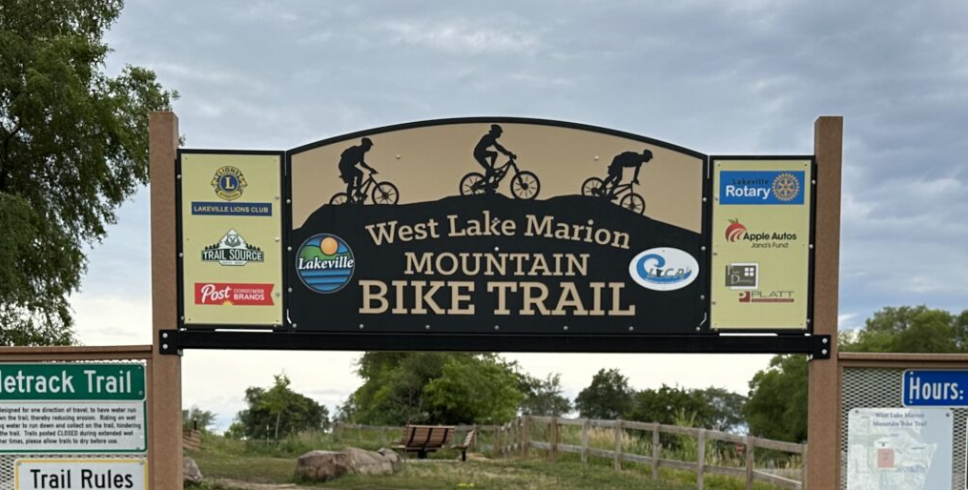
Parks Investment Fund
New fund for 2024
Park dedication fees only
2026–2029 Capital Costs
Park Improvements: $155k
Tech. & Security: $421k
Trail Systems: $412k
2030–2035
Placeholder of $200k/year
All costs inflated 3%/year
Notes:
-Cash payments received must be used only for the acquisition and development or improvement of parks, recreational facilities, playgrounds, trails, wetlands, or open space based on the approved park systems plan. Cash payments must not be used for ongoing operation or maintenance of parks, recreational facilities, playgrounds, trails, wetlands, or open space
-Largest project currently planned will be a $400,000 cost share for the Lake Marion Trail Gap

Slide 25
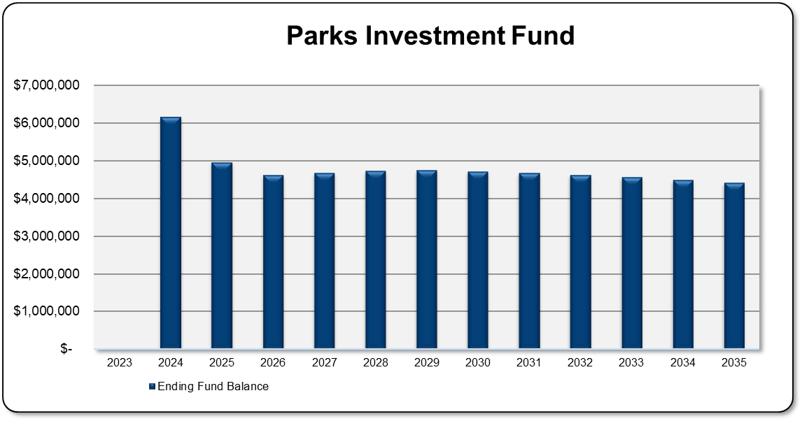
Parks Investment Fund
Next 10 Years
No property tax levy
Assumes $100K of park dedication annually
Only funded with park dedication fees
Potential Bonding
No bonding currently included
Recommended Minimum Fund Balance is 35% of rolling 5-Year Average of Capital Projects
Notes:
-Park Dedication Fees will likely decrease as redevelopment wanes
-Assumes about $100,000 in park dedication fees annually; otherwise, the only funding source will be interest income
-Fund decrease gradually given the relatively small placeholder ($200k adjusted for inflation) and somewhat offset by the modest funding sources
-Doesn’t include $726k in Carry Forward costs in 2025

Slide 26
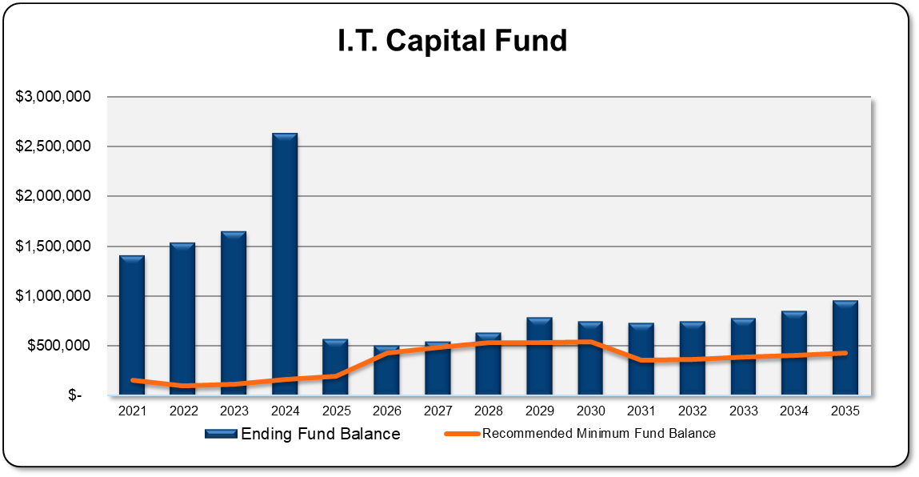
Information Technology Capital Fund
Next 10 Years
$2.8M for ERP System in 2025
Paid with reserves & transfers in
$3.9M in capital projects property tax supported
2026 to 2028: 12% annual increases
2029 to 2035: 6% annual increase
Recommended Minimum Fund Balance is 35% of rolling 5-Year Average of Capital Projects
Notes:
-Does not necessary account for greater use of technology; may become even more ubiquitous
-Also includes a new $25,000 transfer in (adjusted for inflation annually) from the Storm Water Fund; add about $280,000 between 2025 and 2034
-About $2.4 million for an ERP software replacement project (planned for 2025); otherwise, most funds go toward computer and IT infrastructure replacement
-Could consider issuing an equipment certificate to support the ERP software replacement project
-Doesn’t include $1.2M of Carry Forward costs in 2025, of which some may be placeholder and not an actual expense

Slide 27
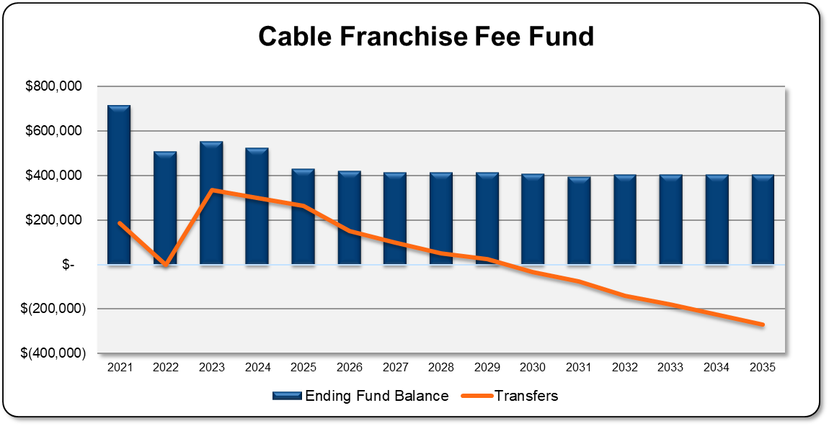
Cable Franchise Fee Fund
Next 10 Years
Supported with cable franchise and PEG fees
Assumes franchise fees decline 4.25% annually
Transfers to General Fund ending in 2030
Goal is to maintain stable balance over long term
Notes:
-Assumes an average annual decrease of about 4.25% in franchise fees between 2026 and 2035
-Transferring out about $265,000 in 2025, which decreases until ending in 2030 and becomes a transfer in of $270,000 by 2035
-Reflects the reallocation of personnel costs from the Cable Franchise Fund to the General Fund back in 2023 – about $500,000 per year
-Doesn’t include $225k in Carry Forward in 2025

Slide 28
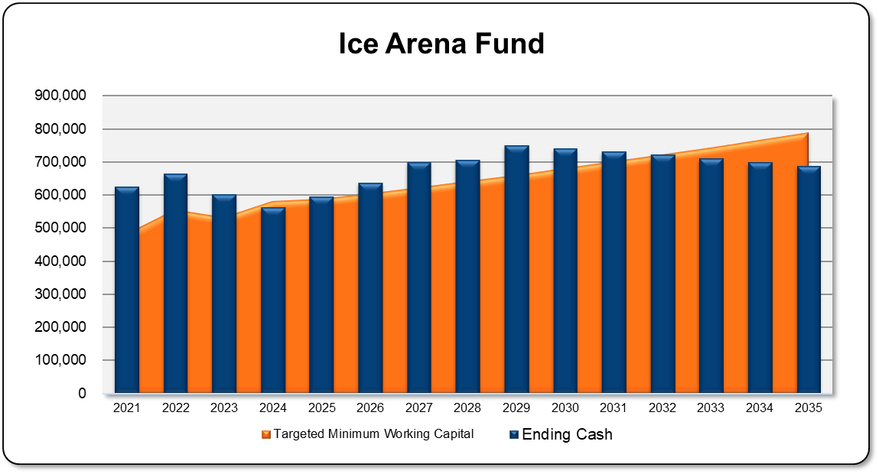
Ice Arena Fund
Next 10 Years
Operating revenues currently cover operating costs
Recommend increasing fees 3% annually
About $580k in capital projects
Excludes $2.0M for activities supported by the Facilities Capital Fund
Targeted Minimum Working Capital is 6 months of operating costs, excluding depreciation
Notes:
-Annual increase in fees needed to keep up with operating costs and protect the position of the fund
-No bonding recommended for this fund at this time
-Adding about $975,000 in cash over the between 2025 and 2034; this fund may be able to pay for a larger portion of capital projects currently paid from Facilities Capital Fund
-Doesn’t include $26k Carry Forward costs in 2025

Slide 29
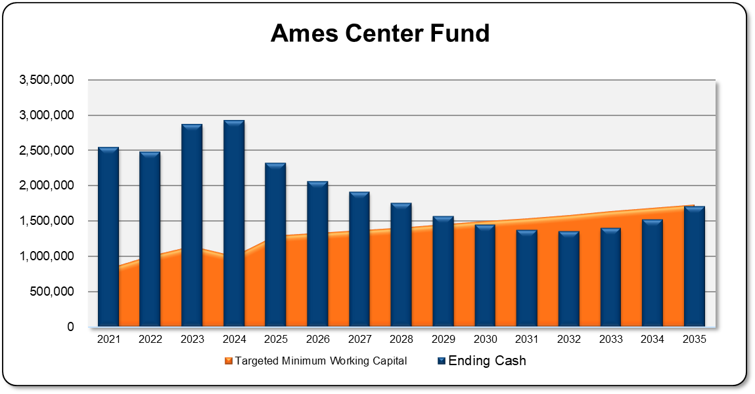
Ames Center Fund
Next 10 Years
Operating revenues do not cover operating costs
Assumes annual fee increases of 5%
Naming Rights decrease to $50k beginning 2029
About $2.0M in capital projects
Does not include $4.3M activities supported by the Facilities Capital Fund
Targeted Minimum Working Capital is 6 months of operating costs, excluding depreciation
Notes:
-Between 2025 and 2032, the fund projects a decrease in cash of about $118,000 annually; finally increasing in 2033 and beyond
-Charges for services increases 5%/year to slow the downward trajectory of reserves
-Naming rights currently $165,000 annually (until 2028), then reduced to $50k/year
-In addition to the capital costs, the fund does not support any outstanding debt service; about $4.9 million remaining (between 2025 and 2027)
-Between current capital needs and outstanding debt service, the fund does not support about $9.2 million in associated costs
-Doesn’t include $105k in Carry Forward costs in 2025
-The City will need to identify additional funding sources or consider operational changes for the Ames Center
-Operating revenues next of depreciation exceed operating costs beginning in 2031

Slide 30
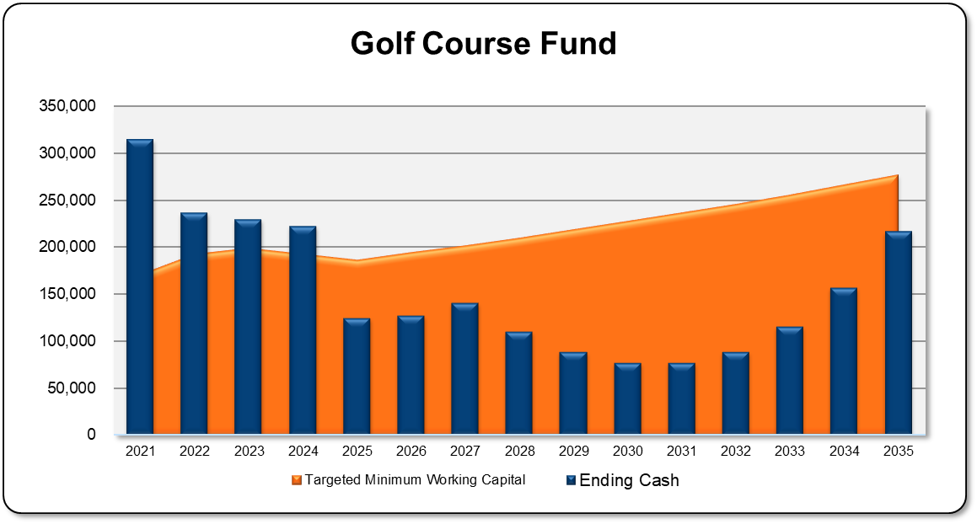
Golf Course Fund
Next 10 Years
Current operating revenues covers operating, but not enough for capital needs
Assumes annual fee increases of 6%
About $1M in capital projects
Does not include $88k activities supported by the Facilities Capital Fund
Targeted Minimum Working Capital is 6 months of operating costs, excluding depreciation
Notes:
-The fund remains under its fund balance requirement and enters a negative position in 2028
-4% annual increase will be insufficient to support the operations and capital costs
-May need to increase the fees, subsize with the property tax levy and/or assign ALL capital projects from the Golf Course Fund to the Facilities Capital Project Fund
-Doesn’t include $47k of Carry Forward costs in 2025

Slide 31
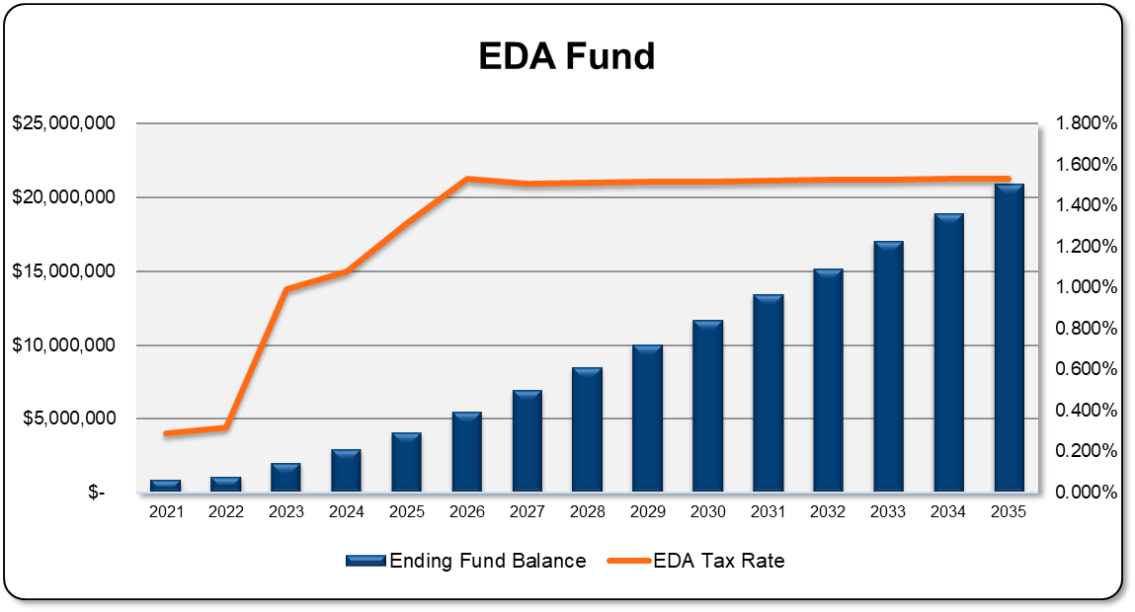
EDA Fund
Next 10 Years
2025 Property Tax Levy of $1.5M
Property Tax Levy at statutory maximum by 2026 & continues at that level
Does not include any new program costs
Notes:
-Do not say “war chest”
-Provides about $20.9 million by the end of the planning period in 2035
-Will begin to contribute more than $1 million annually to fund balance beginning 2025 and $1.5 million by 2028
-Statutory maximum of 0.01813%
-Supporting an average annual operating budget of about $471,000

Slide 32
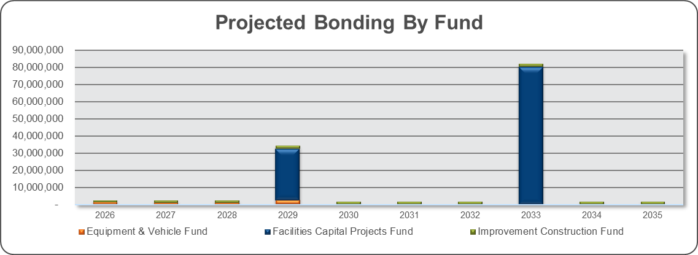
Potential Bonding
Notes:
-Relatively modest borrowing need over the projection period for non-facility related projects
-The Improvement Construction Fund bonding reflects special assessment project completed by the City
-Does not include any bonding related to utility funds, which are not included in the FMP
-Additional equipment certificates beyond 2029 may need to be issued for the Equipment and Vehicle Fund

Slide 33
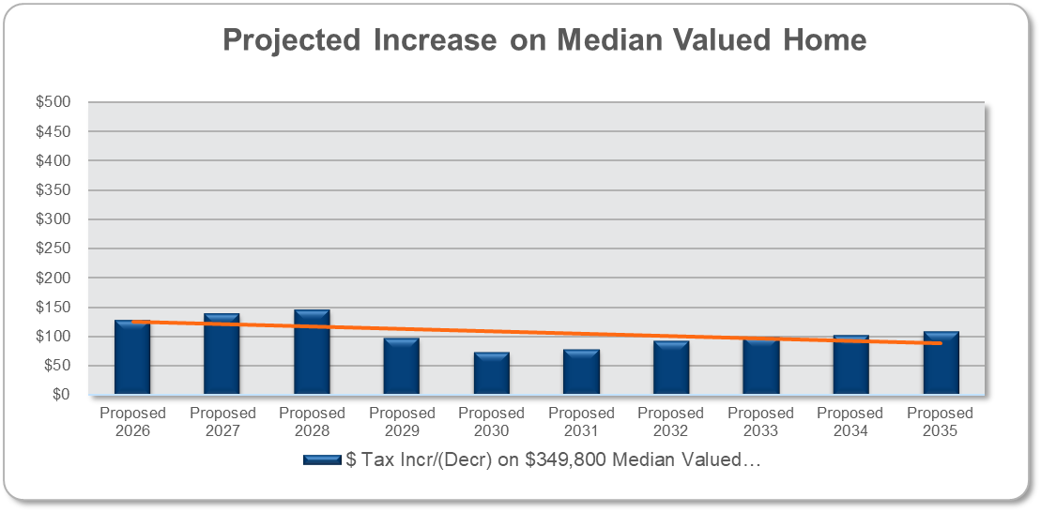
Impact on Median-Valued Home
Next 10 Years
State law changes impact Residential Homesteads
2026: $129/year ($11/$.36) = 8.4%
2027: $139/year ($12/$.39) = 7.3%
2028: $146/year ($12/$.40) = 8.4%
Other Years: $94/year average
Assumes 2% annual increase in existing property values
Notes:
-Assumes a median-valued home of $349,800
-Includes an assumption for a 2% increase in valuation annually

Slide 34
Conclusion
The FMP Update responds to the strategic direction of the City Council as well as the needs of the Burnsville community
Some of the issues may take a few year to address
Biggest impact found in 2025 through 2027
Need to balance financial needs with Strategic Priorities
Non-binding property tax levy changes in effect until 2027
Limited property tax support debt for capital projects to reduce tax impact
Monitor the balances of various funds
Notes:
-Primarily due to changes in the General Fund as result of the non-binding property tax levy commitments
-Together, we create great experiences for our community

Slide 35
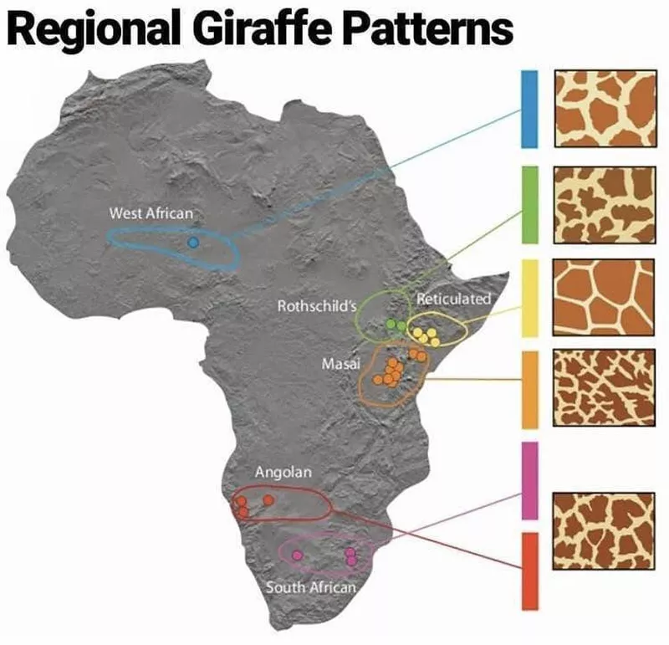

Slide 36
Thank you! Questions?

